Slide 1

Full Emulation For Enterprise Network & Security Infrastructure
Supervised By :
Dr/ Mohamed Ashraf Madkor

Slide 2
Name | No.
Mohammed Samy Hussein | 97
Abdallah Adel Abdallah | 67
Ahmed Adel Hussien | 9
Abdallah Mohammed Ahmed | 69
Mohamed Farag Abd Elhalem | 114
Presented By :-

Slide 3

TABLE OF CONTENTS.
Abstract
Headquarter & Protocol
Service provider
Data Center.
Security Features.
FortiGate Firewall

Slide 4
Abstract
Our project main idea is to build a network infrastructure suitable to maintain traffic between departments on a different sites , how they connect together, and how clients can connect to this network and benefit from the enterprise services by optimizing the network to be in its full functionality, putting in mind security concerns using the most recent security policies using Fortigate(from Fortinet) Firewall ,and applying it using a simulation software and VMs to apply the Idea.
In order to make things clear we assumed that we have 2 branches of CIB bank one on Cairo and the other in Alexandria , and they wish to connect to each other , so we provided it with the right protocols and infrastructure needed to make that connection reliable throw the whole session

Slide 5
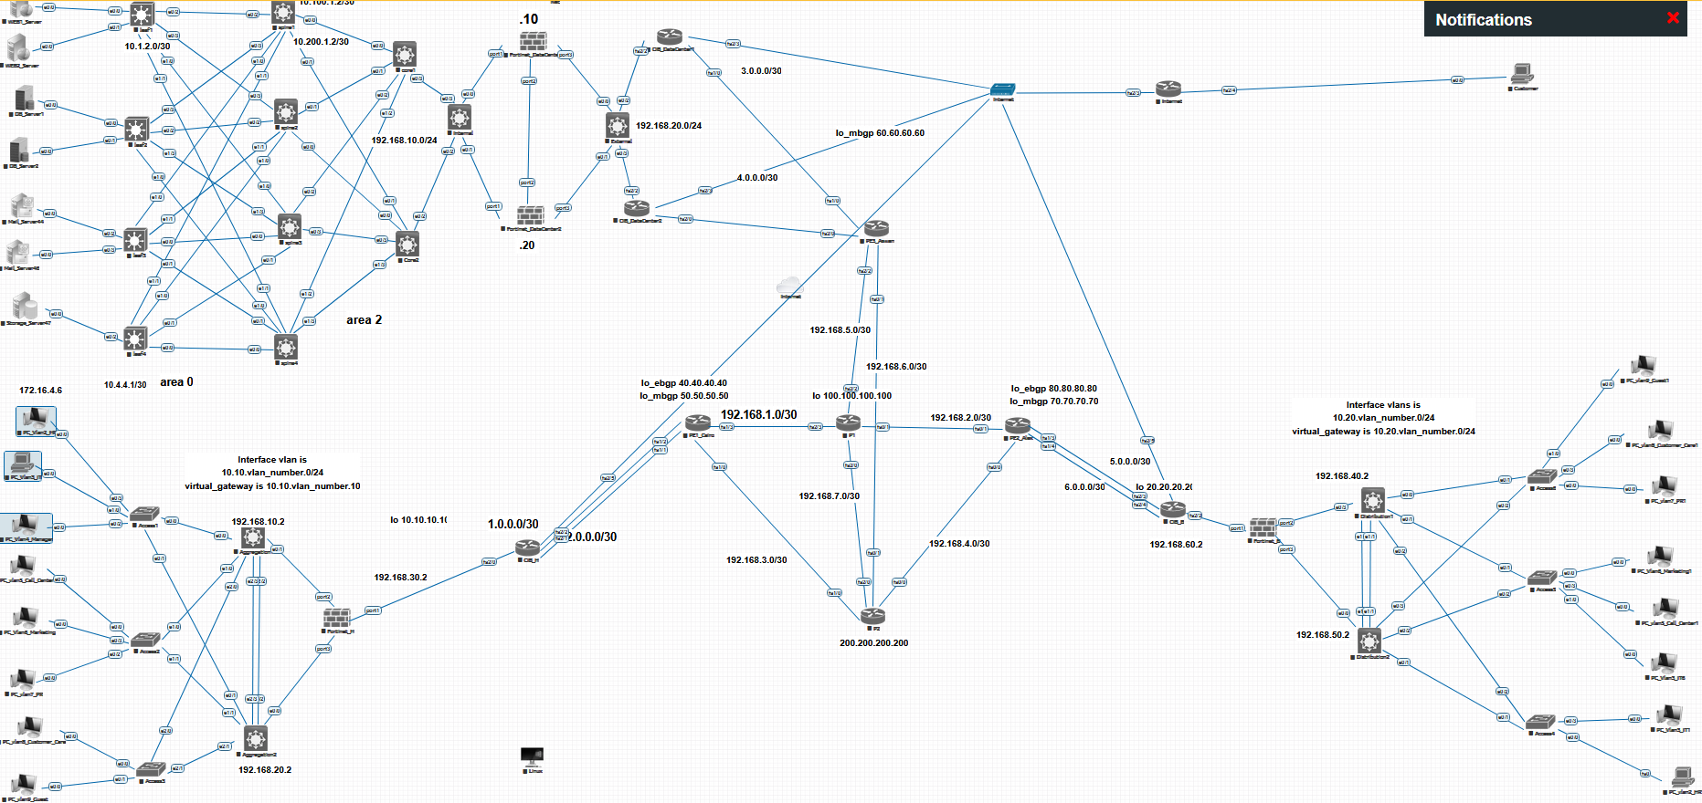
Full Topology Design

Slide 6
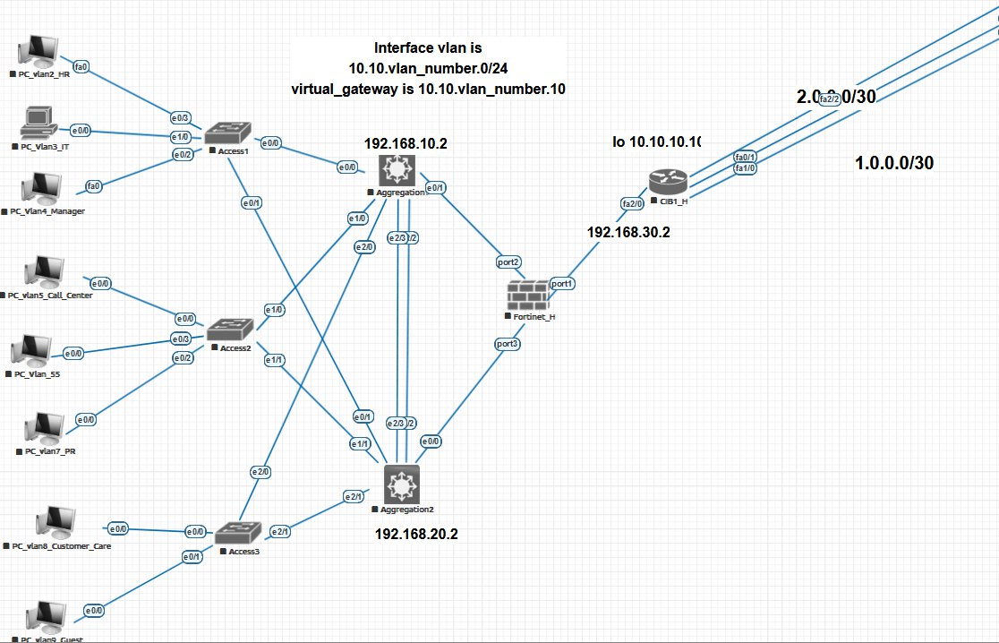
Headquarter design.
WE USE 3-TIER DESIGN WITH COLLAPSED CORE.

Slide 7
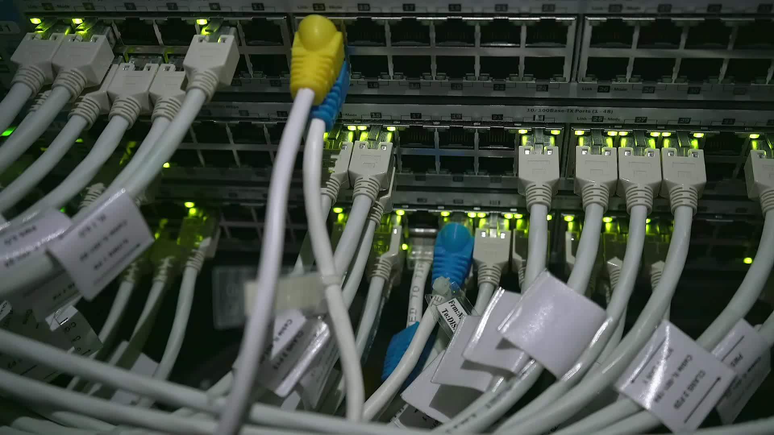
Network Protocols And features
HSRP
VTP
MSTP
LACP
OSPF

Slide 8
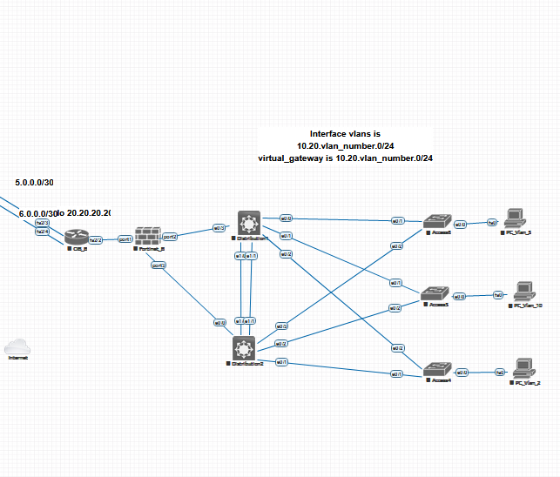
BRANCHES design.
SAME AS HQ DESIGN ,WE USE 3-TIER DESIGN WITH COLLAPSED CORE.

Slide 9

Network Protocols And features
HSRP
VTP
PVSTP
LACP
OSPF

Slide 10
Service provider
Who is the service provider ?
What is the difference between service
provider ( SP ) and Internet service provider ( ISP )?
What is the difference between public and private WAN ?
Why old techniques is bad ?

Slide 11
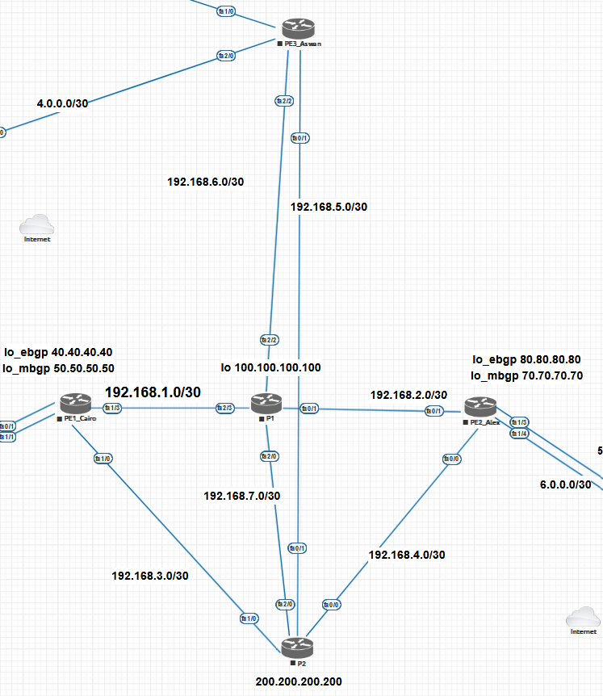
Service provider Design
Provider routers ( router reflector )
P1
P2
Provider edge routers
PE1_Cairo
PE2_Alex
PE3_Aswan

Slide 12
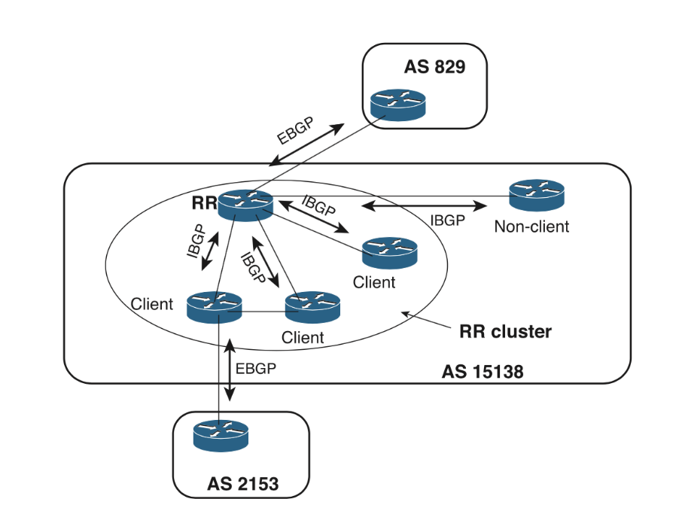
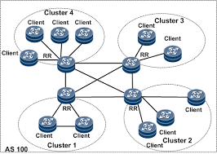
Neighborship attitude
Route reflector neighborship ( RR )
Provider edge neighborship ( Client )
RR cluster ID
Originator ID

Slide 13

Implementation of protocols and features
OSPF ( for pingable network )
BGP ( External Neighborship )
BGP Router reflector ( Internal Neighborship )
MPLS activation ( LDP Protocol )
BGP and MPLS Authentication
Multi-protocol BGP
VPNV4 address family
Route distinguisher ( 96 bits )
Route target ( 64 bits )

Slide 14
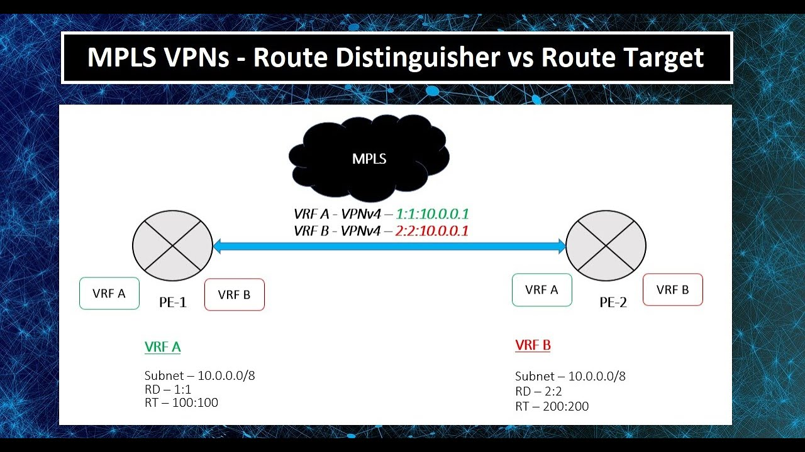

Slide 15
Verify
BGP peering : show ip bgp summary
Verify
BGP Routes : show ip bgp
Verify
MP-BGP Configuration: show bgp vpnv4 unicast all summary
Verify
MPLS Configuration: show mpls forwarding-table
Testing and assurance

Slide 16
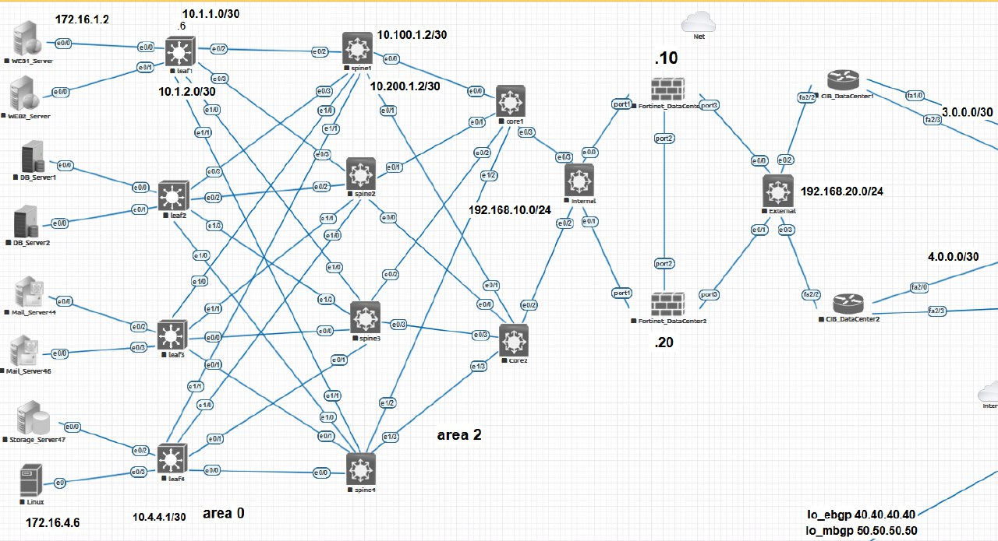
Data Center Topology
Spine-Leaf Data Center Design

Slide 17
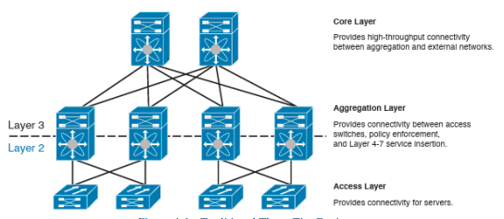
Traditional Design
Traditional Three-Tier Design

Slide 18
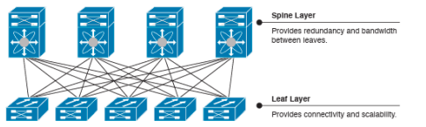

Spine-leaf topologies are based on the Clos network architecture.
Modern Design

Slide 19

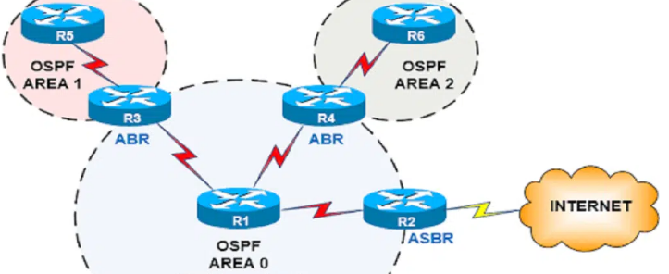
Data Center protocols
OSPF (Open Shortest Path First) is a link-state routing protocol that is widely used in data center , large enterprise networks and service provider networks.

Slide 20

Security Features

Slide 21

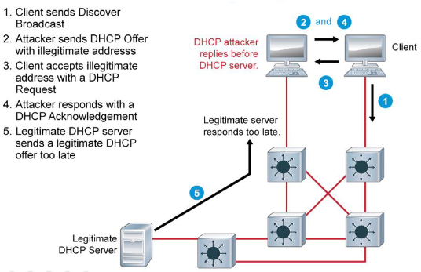
DHCP Attacks- DHCP Server spoofing

Slide 22
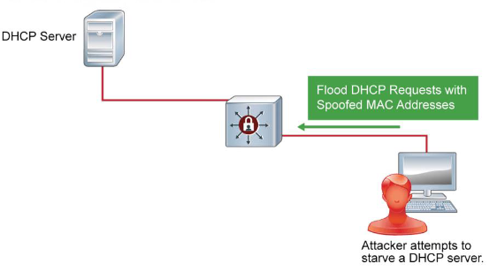
DHCP Attacks- DHCP Starvation

Slide 23
Preventing DHCP Spoofing & DHCP Starvation Attacks
Enable DHCP snooping
Configure trusted ports
Implement VLANs

Slide 24

FortiGate Firewall

Slide 25

What’s a firewall ?
Hardware firewalls
Software firewalls
Next generation Firewall
Why FortiGate ?

Slide 26
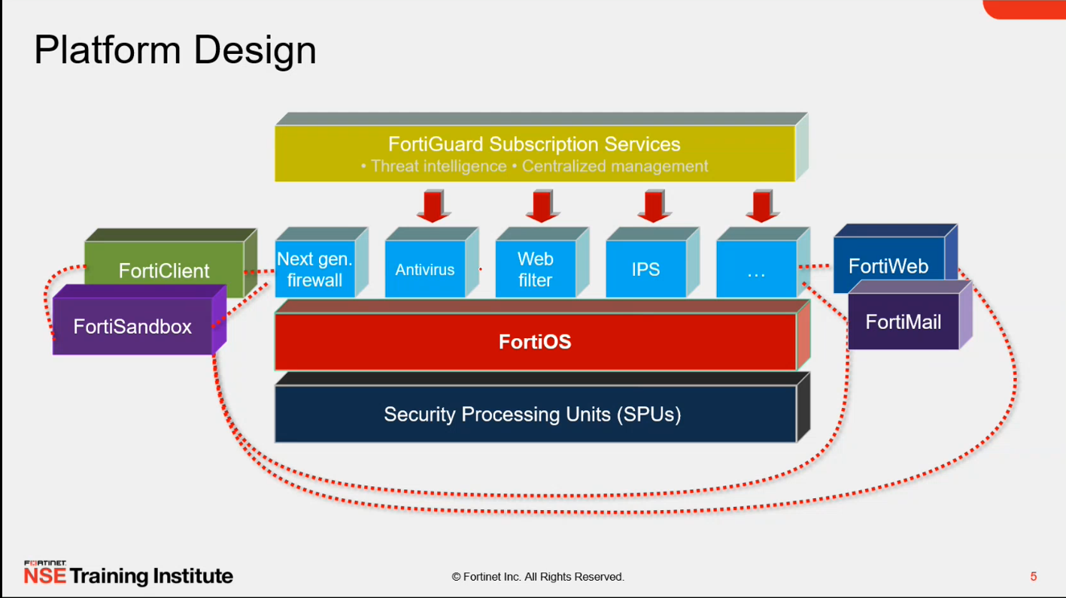
FortiGate Structure

Slide 27
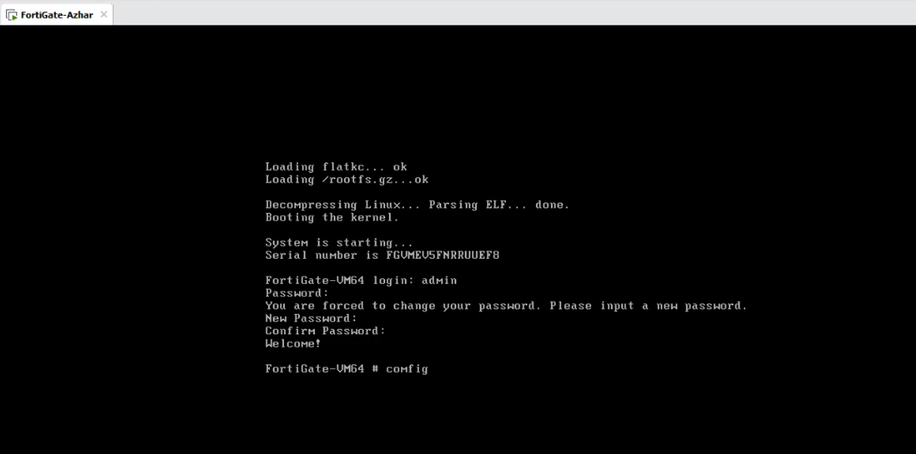
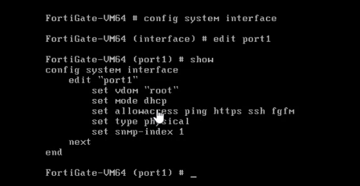
FortiGate-VM kernel setup
VM setup & configuration

Slide 28
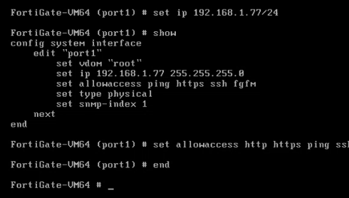
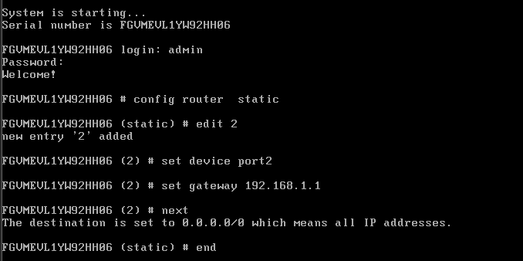
Port & default gateway setup

Slide 29

Security Profiles

Slide 30
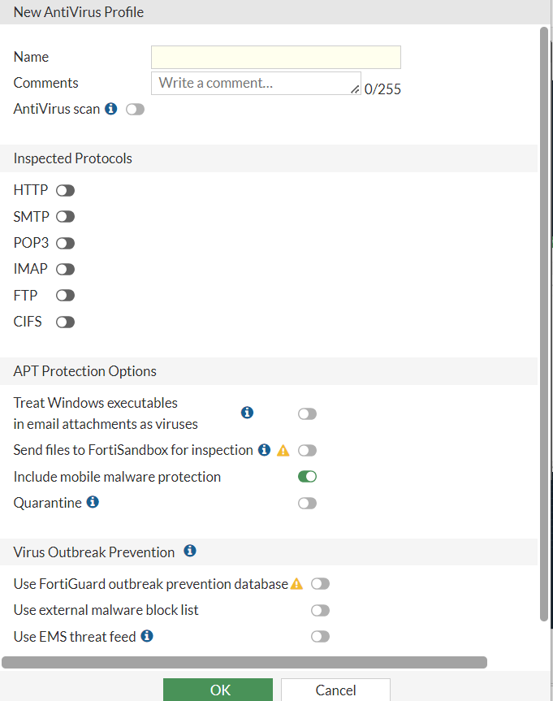
AntiVirus

Slide 31
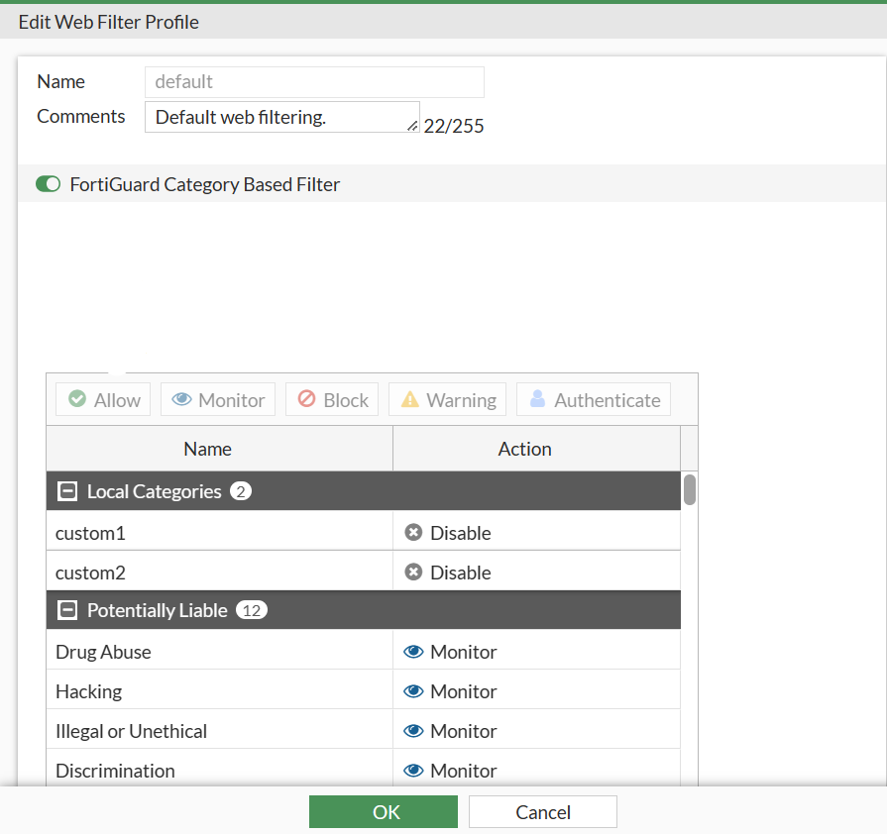
WebFilter

Slide 32
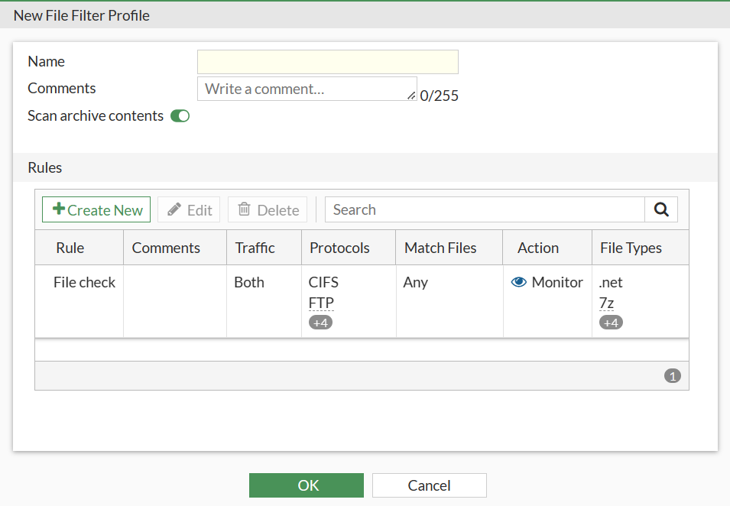
FileFilter

Slide 33

THANKS

